Slide 1

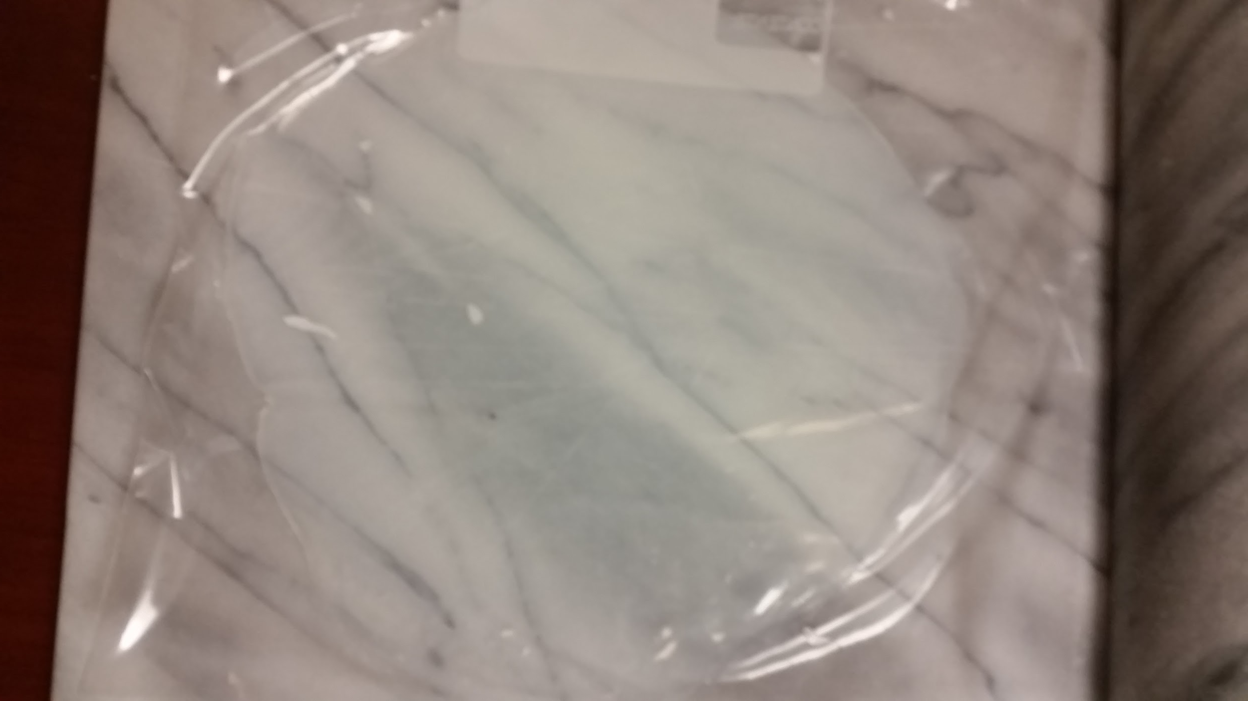
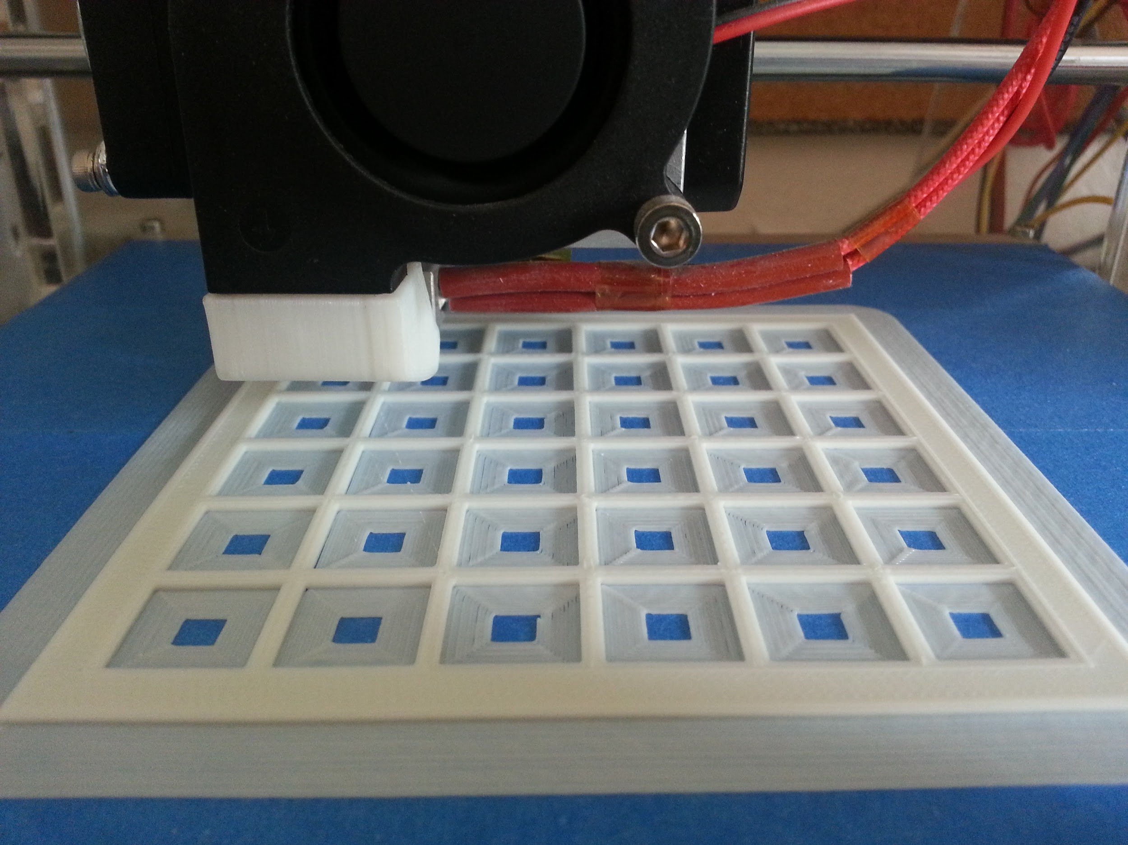
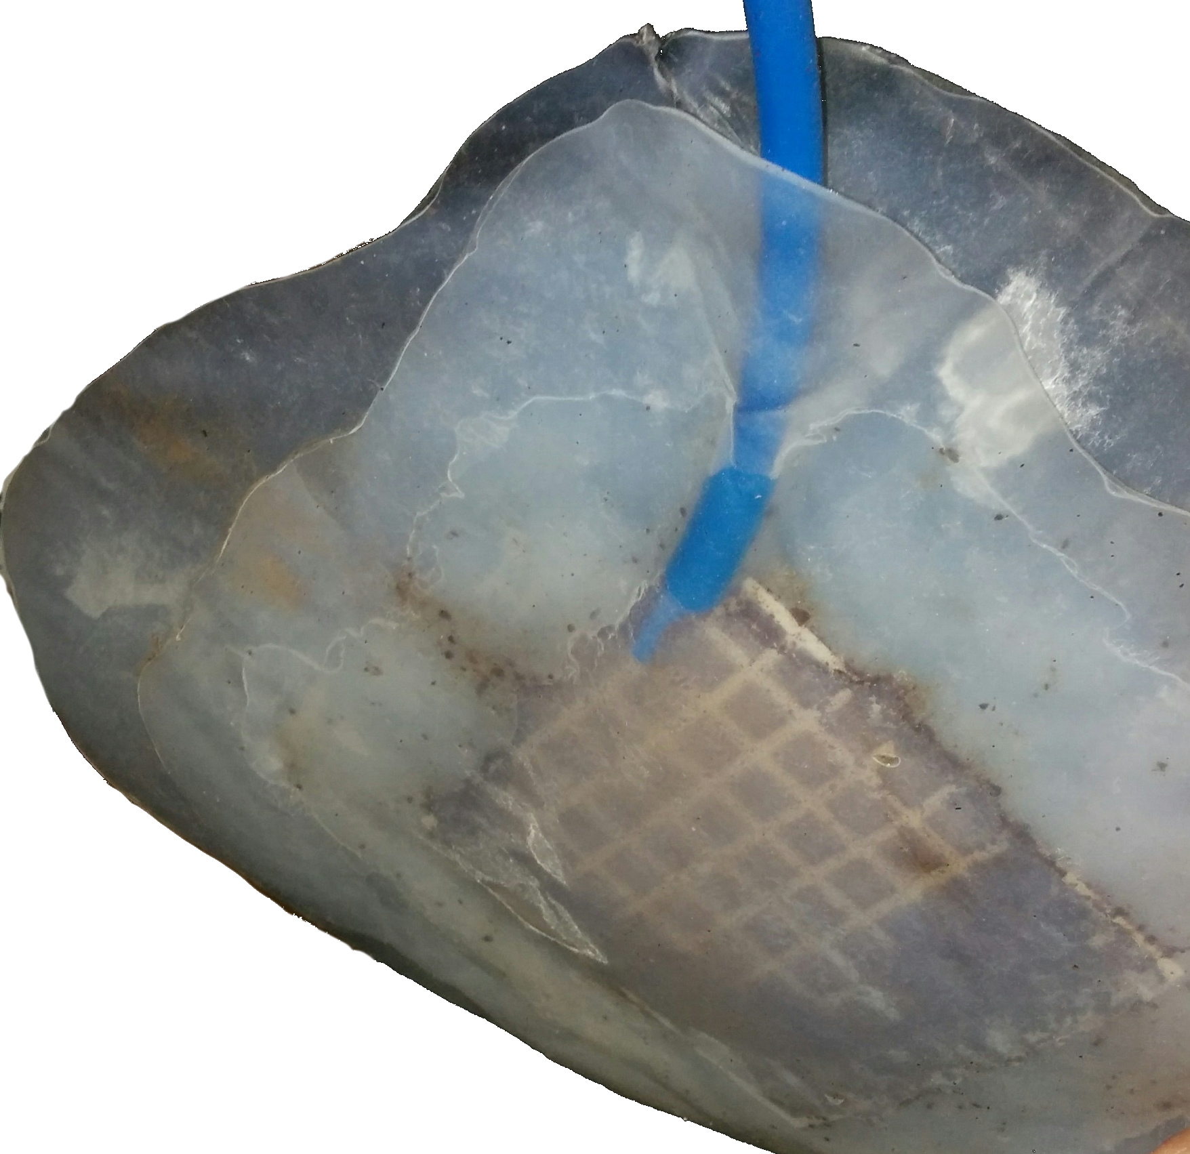
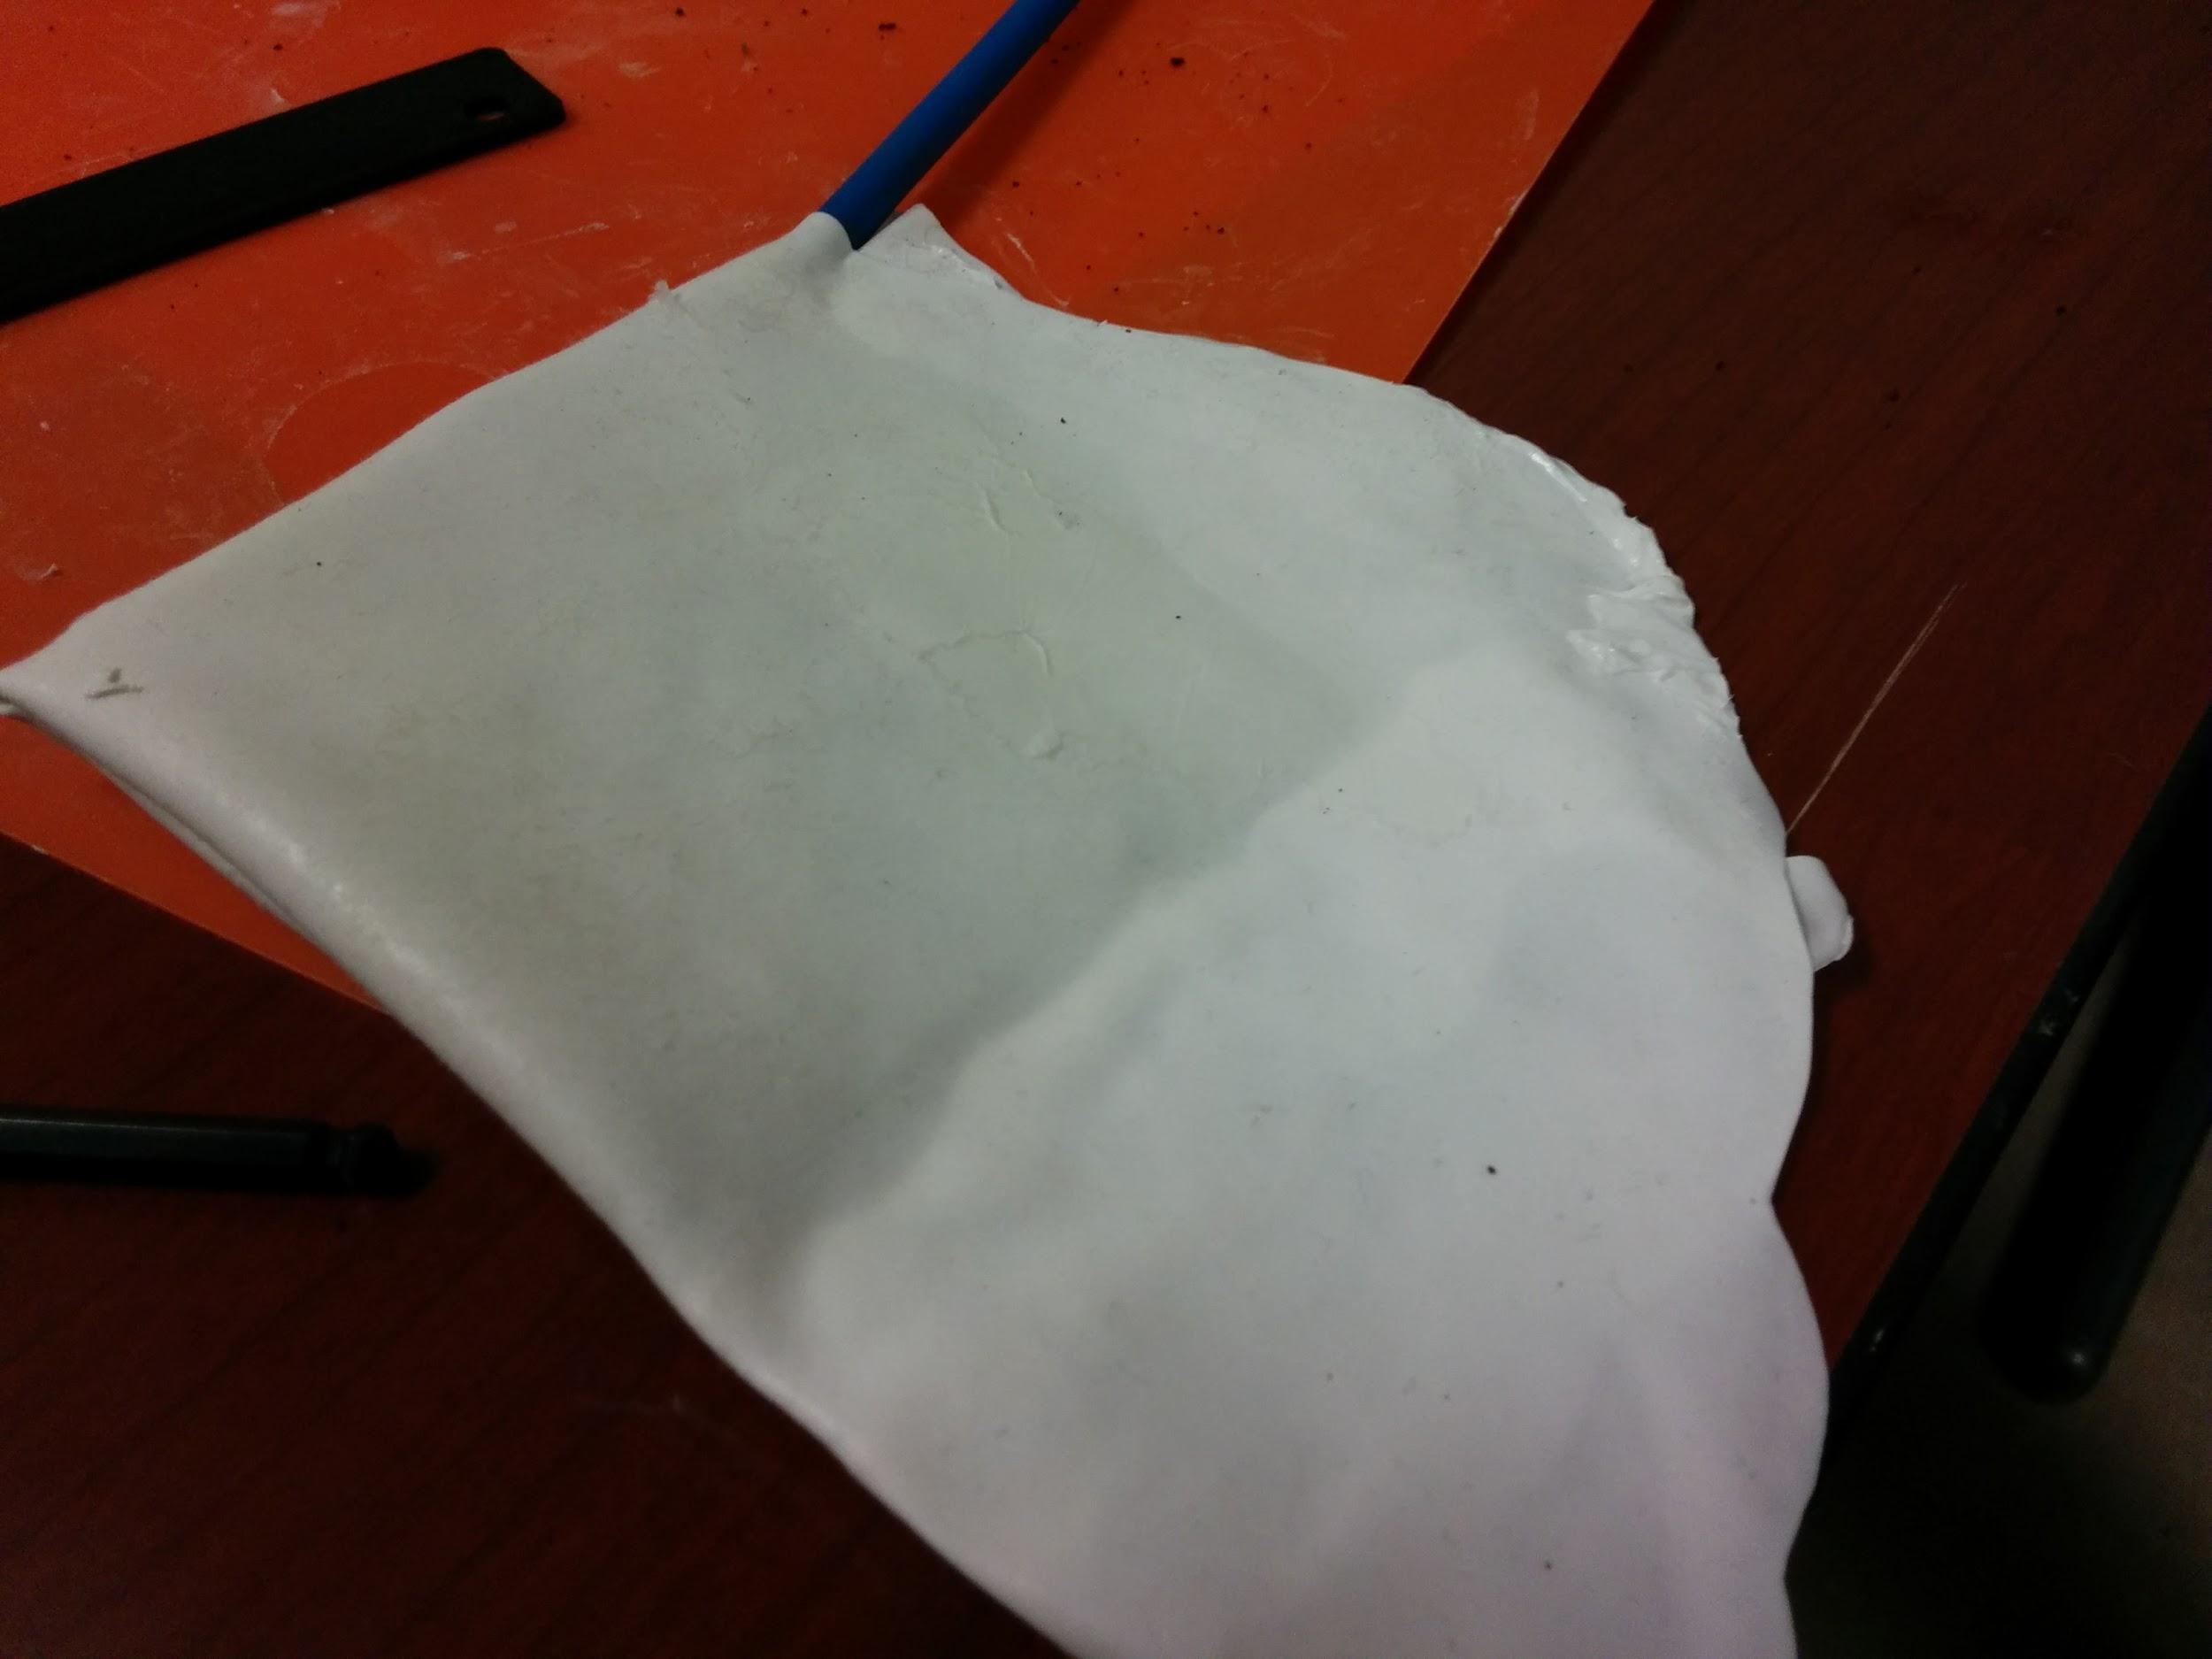
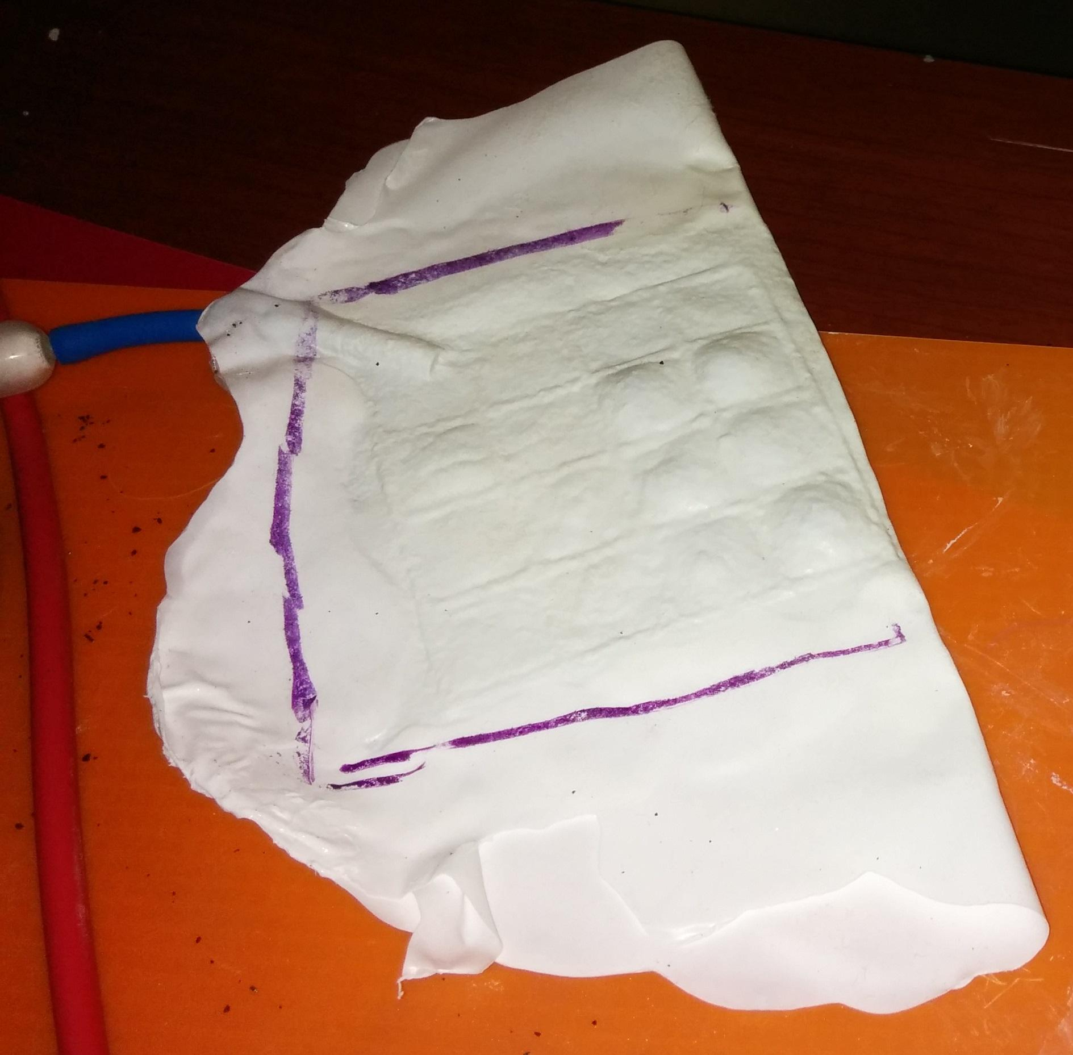
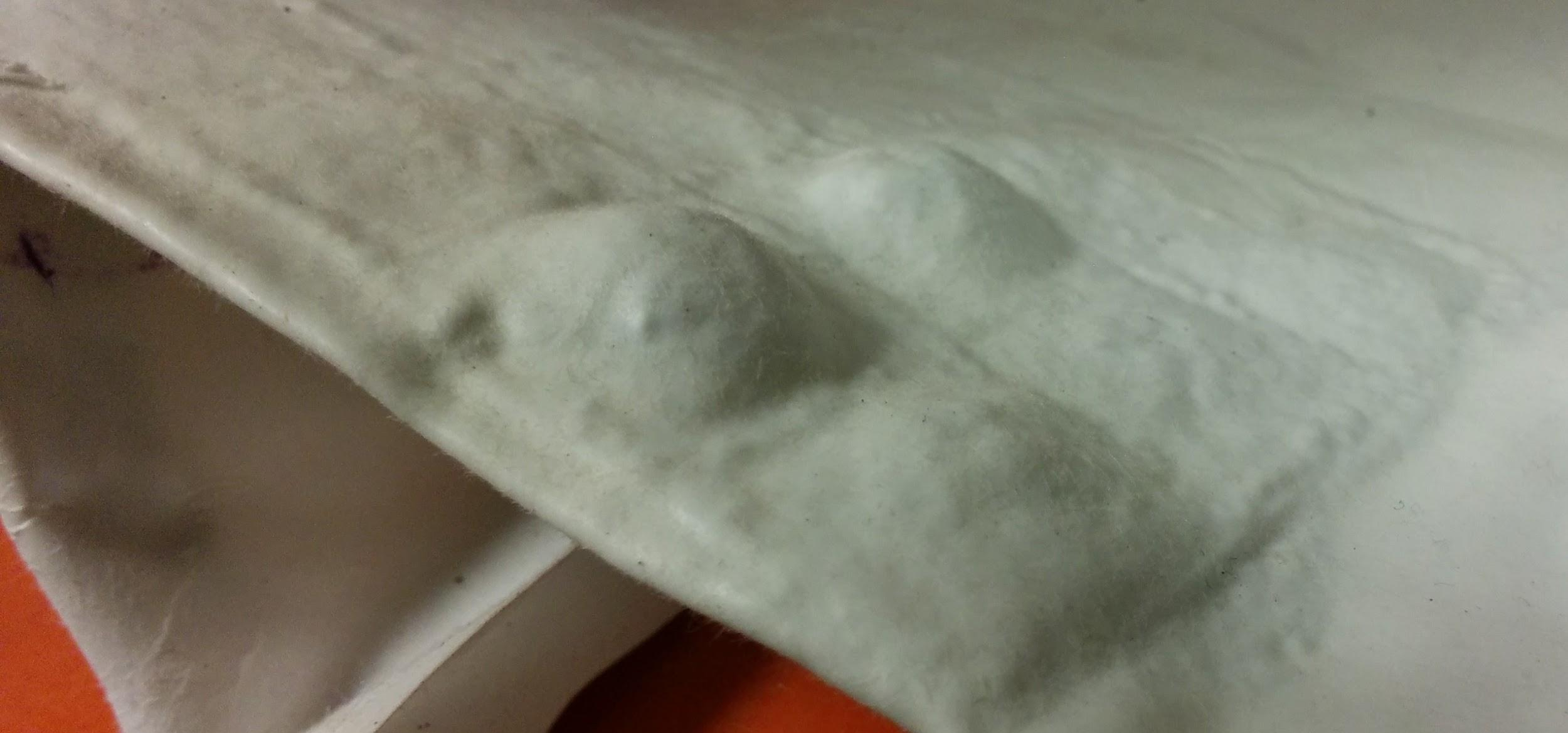
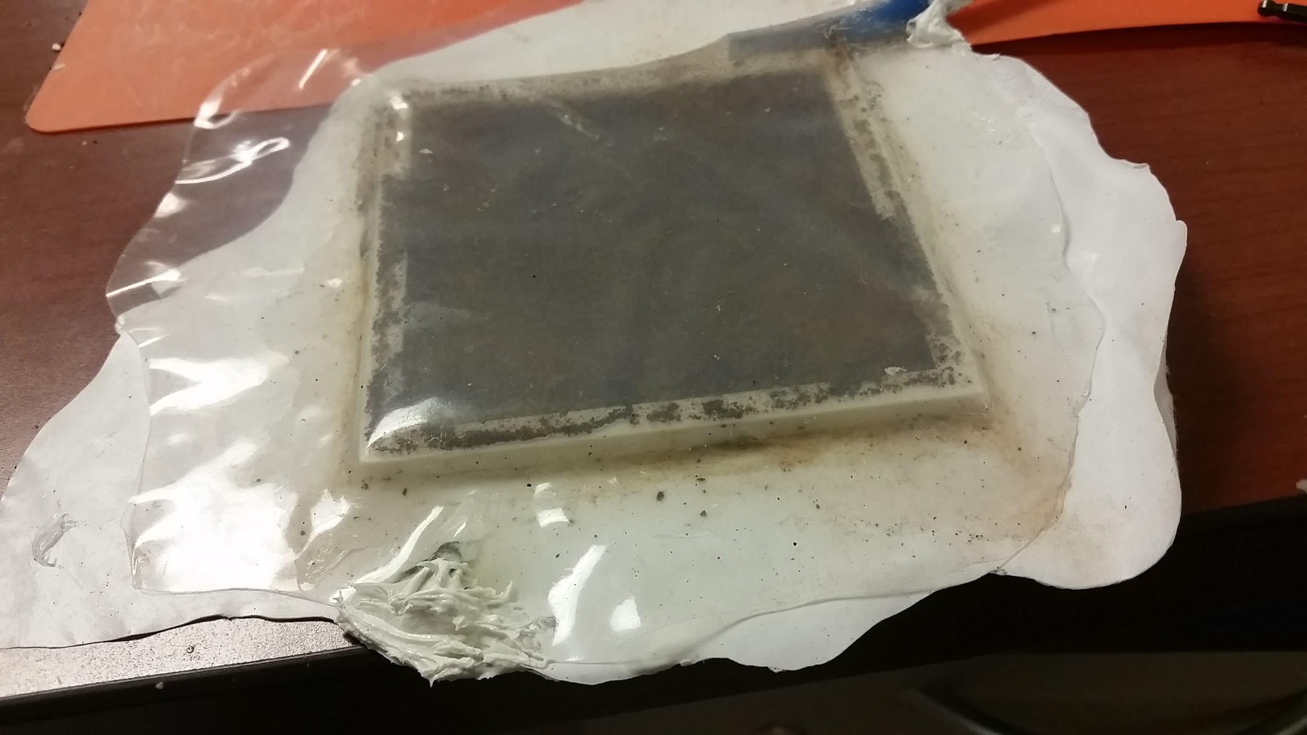
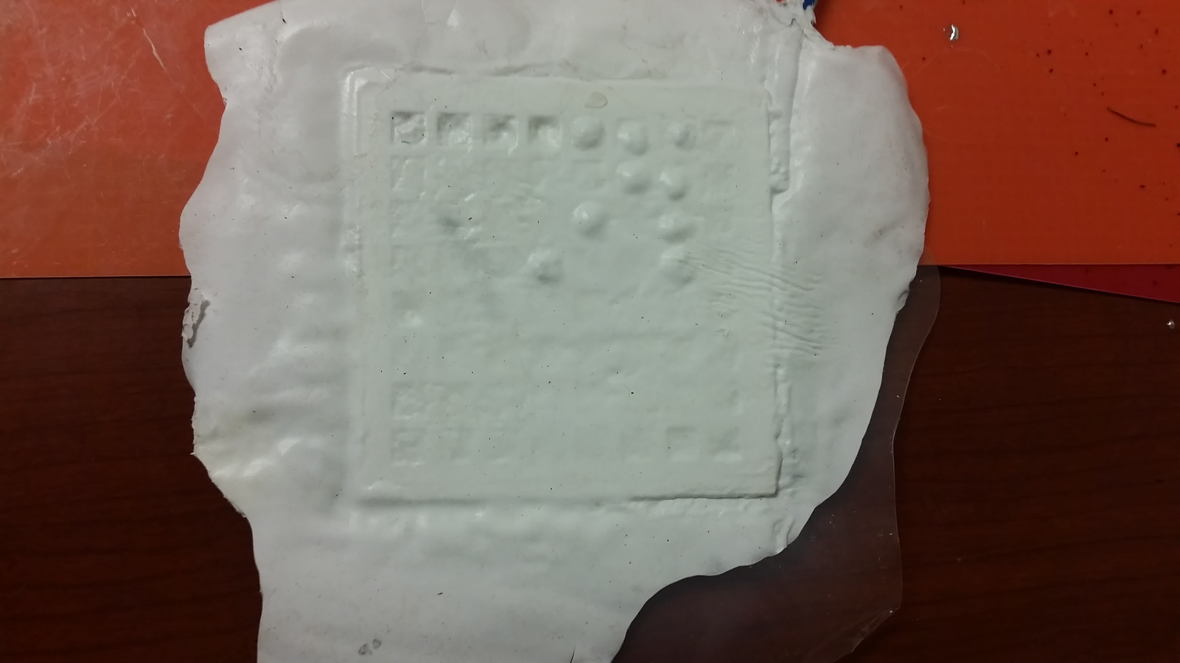
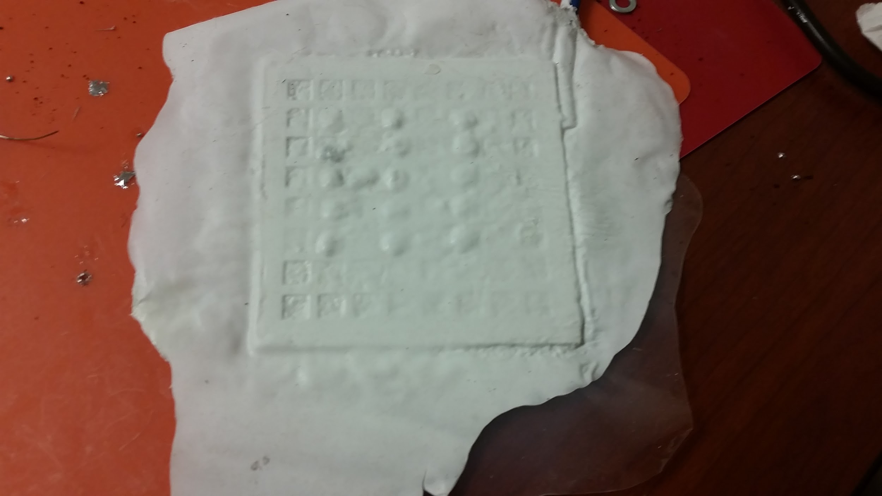
Alternative Tactile Display Using Granular Jamming Leon Cao, Niraj Patel, Paul Dao, Kevin Truong Professor Gillian Hayes, Mark Baldwin Donald Bren School of Information and Computer Sciences
Goal: Produce an affordable, scalable, and DIY-able tactile display leveraging concepts of granular jamming
Introduction
Refreshable braille displays currently on market are unaffordable for most braille readers, due to the intricate technology used. In fact, typical 40-cell displays could go for above $2,000 per unit. However, granular jamming provides a technique for creating a more affordable and scalable refreshable tactile display, which can be used to convey graphic information in a visual-less manner. Granular jamming refers to the phenomenon where granular material such as coffee or sand grains become rigid but malleable in a vacuum. This phenomenon has been used in robotics to create universal gripper arms that can grab objects of varying shapes. However, little research has been done on exploiting this phenomenon to create a braille display or to convey graphic information. Some research has focused on using granular jamming as a way to provide haptic feedback, but otherwise few applications for a tactile display actuated via granular jamming have been explored.
We plan to explore the many potential applications of a granular-jamming-based tactile display, specifically in the realm of refreshable braille displays and image imprinting. Compared to commercially available braille displays, granular-jamming-based tactile displays are very simplistic and inexpensive to manufacture. Additionally, they can create low-resolution tactile images, which can be used in schools or storybooks to help visually-impaired children experience illustrations and graphic descriptions they otherwise cannot see. We hope that our project will pave the way to several different real-life applications that this technology will be able to provide in the future.
Implementation
Affordability, scalability, and DIY-ability are the primary goals of this project, so all required components are easily acquired or assembled via 3D printing and off-the-shelf parts from makerspaces or hardware stores. As such, the tactile display only consists of a simple 3D-printed frame as well as spent coffee grains, sealed airtight between sheets of silicone caulk.
After every cell in the frame is filled with coffee grains, tactile bumps are created by evacuating air from the display and simply pressing against the grains. When jammed against each other due to a lack of air, the grains provide sufficient friction to overcome gravity. As a result, any shape created in the jammed state stays until air is reintroduced. Since silicone is durable and flexible, it provides moving room for the grains in the jammed state. Furthermore, by its elasticity, the silicone restores the original display shape when air is reintroduced, un-jamming the grains.
To automate the process of imprinting display cells, a CNC program is loaded onto a microcontroller. Before a tactile image is created, an air pump activates to evacuate air out of the display and jam the grains. To imprint a pattern of raised cells, a pinhead on an XY platform is used and controlled via sequences of G-codes from a connected computer. To clear a tactile image, another air pump activates to reintroduce air into the display, unjamming the grains and restoring the original flat display shape.
3D-printed support structure
Uncured silicone sheet
A failed prototype
Team 33: General Tactile
Member | Major | Responsibilities
Mark Baldwin (Advisor) | Informatics | Inspiration for original project idea. Provide materials and lab space to build prototypes.
Leon Cao | CSE | Research and develop mechanical structure. Design and program control systems for display and XY platform.
Paul Dao | CSE | Work on embedded programming to implement XY platform. Work on image processing software.
Niraj Patel | CSE | Work on software for XY platform and air flow control system. Work on image processing software.
Kevin Truong | Engr. EE | Assist in implementation of XY platform. Work on circuitry for breadboard control system.
Find us on http://srproj.eecs.uci.edu/projects/alternative-tactile-display-using-granular-jamming
Contact us at msbaldwin@gmail.com or gcao@uci.edu
Working prototype 1: Unjammed
Working prototype 1: Jammed
Working prototype 1: Closer look
Schedule
Nov. 2016
Granular display prototype
Dec. 2016
Final display prototype
Jan. 2017
Granular display controller
Feb. 2017
XY platform prototype
Mar. 2017
Complete granular display with auto control
Display with cell size, grain amount, support structure finalized
Computer-controlled pinhead with 3 degrees of freedom for display imprinting
Working prototype 2: Unjammed
Working prototype 2: Sample pattern 1
Working prototype 2: Sample pattern 2
Fully functional manually-operated display prototype
Automatic control for jamming/unjamming display via air pumps and solenoid valves
Integration of final granular display, its controller, and 3-DOF pinhead into a final product
Notes:
1

